Slide 1
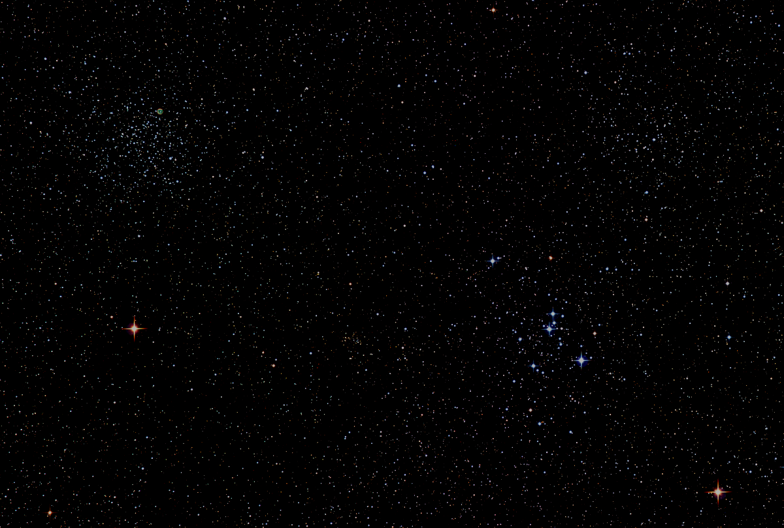

Howard
Astronomical
League
19
March 21st, 2019
Notes:
Howard Astronomical League, June 21, 2018

Slide 2
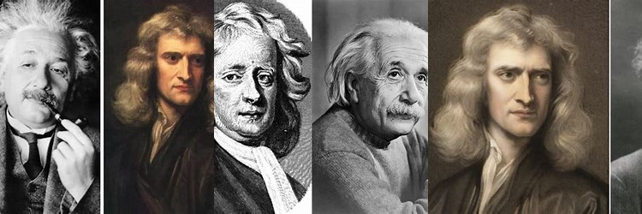
Introductions
Sponsored by: Famous Astronomers that could really use a haircut.

Slide 3
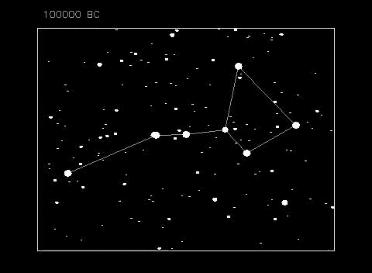
The Big Dipper – Proper Motion 100,000 BC to 100,000 AD
Courtesy of Dr. Richard Pogge – Astronomy Professor at Ohio State University
Thanks to Pat Pitts for bringing this to our meeting.
Submitted by Herman Heyn

Slide 4
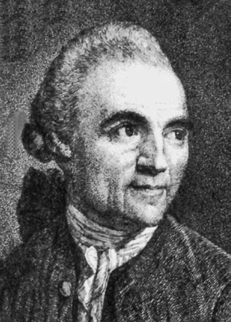
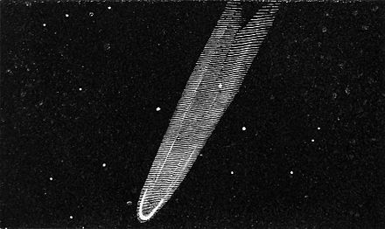
Astronomy News – 200 Years Ago
The Great Comet of 1819
The Great Comet of 1819, officially designated as C/1819 N1, also known as Comet Tralles, was an easily visible brilliant comet, approaching an apparent magnitude of 1–2, discovered July 1, 1819 by Johann Georg Tralles in Berlin, Germany. It was the first comet analyzed using polarimetry, by François Arago.
Johann Georg Tralles
Oct 15, 1763 – Nov 19, 1822
Great Comet of 1819 from Uranography
Drawn by E. Otis Kendall (1850)

Slide 5
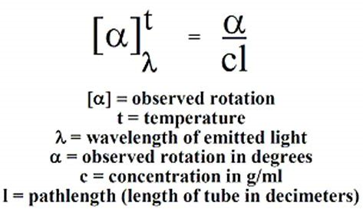
Definition: Polarimetry
Polarimetry is the measurement and interpretation of the polarization of transverse waves, most notably electromagnetic waves, such as radio or light waves. Typically polarimetry is done on electromagnetic waves that have traveled through or have been reflected, refracted or diffracted by some material in order to characterize that object.

Slide 6
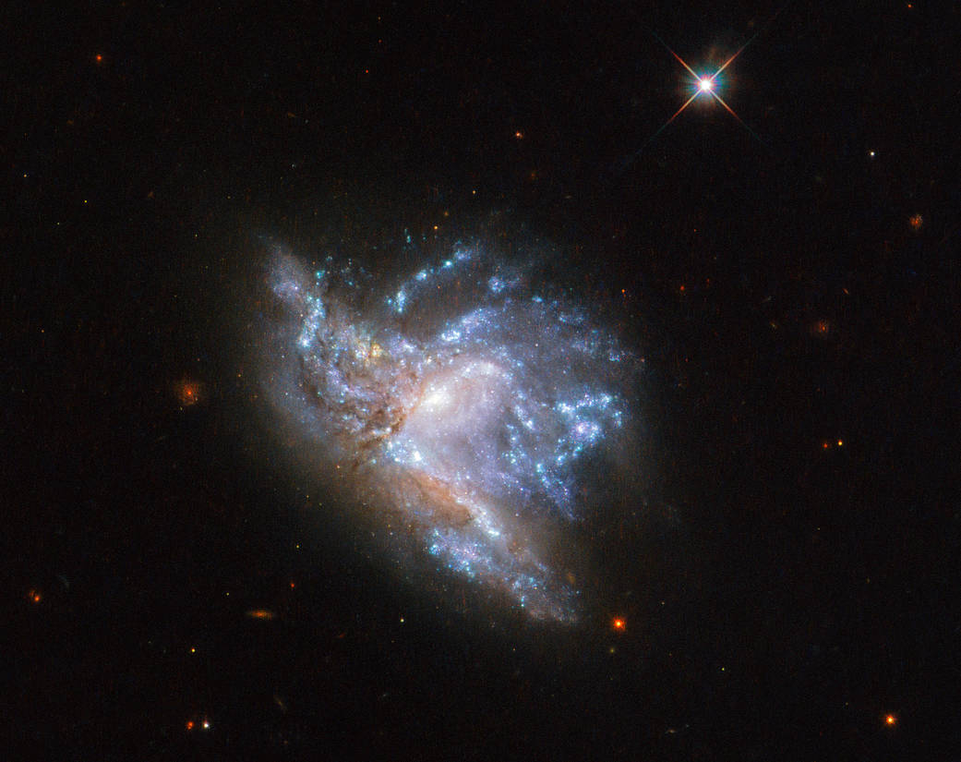
Current Astronomy News
Hubble: Colliding Galaxies – NGC 6052
Located in Hercules 230 Million Light Years Away
Discovered in 1784 by William Herschel and was classified as an “Irregular Galaxy”
Text credit: ESA (European Space Agency)
Image credit: ESA/Hubble & NASA, A. Adamo et al.

Slide 7

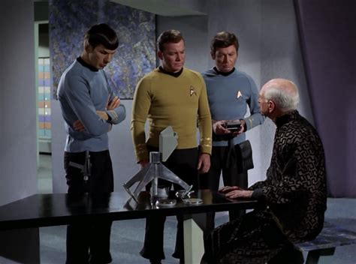
Astronomy News – Future (250 yrs)
Stardate: 5943.7
Captain - James T. Kirk – USS Enterprise
Captains Log: We have calculated that Beta Niobe will go nova in approximately three and a half hours. Its only satellite, Sarpeidon, is a Class M planet, which at last report was inhabited by a civilised humanoid species. Now our instruments show that no intelligent life remains on the planet.
Chief Medical Officer – Dr. Leonard H. “Bones” McCoy
Heard to say: How can a planet full of people just disappear?

Slide 8
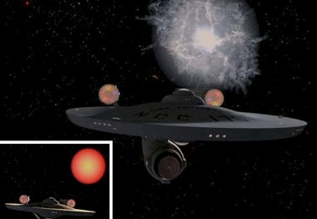
Astronomy News – Future (Cont’d)
Beta Niobe: Super Nova in 2269

Slide 9
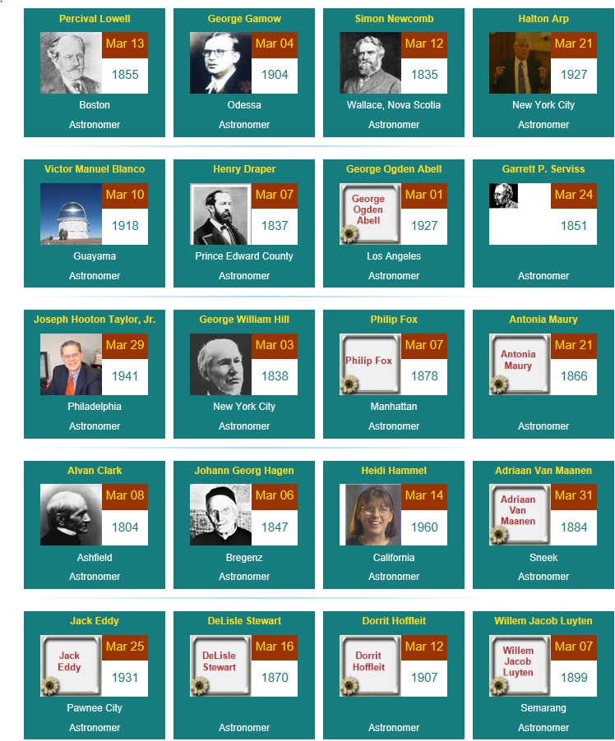
Happy March Birthday’s U.S. born Astronomers

Slide 10

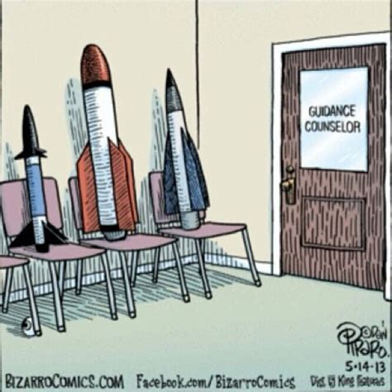
Astronomy Humor

Slide 11
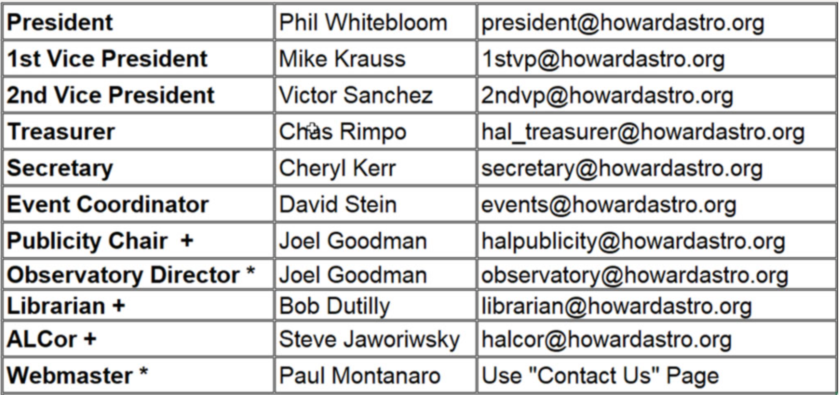
Officers Reports

Slide 12
This Evening’s Speaker
Dr. Albert Holm
Former staff member for OAO-A2, the International Ultraviolet Explorer, and the Hubble Space Telescope
Out of this World Astronomy: The Orbiting Astronomical Observatory-A2
Notes:
It is my distinct pleasure to introduce Dr. Bindu Rani. She has been a Postdoctoral Fellow at NASA/Goddard Space Flight Center since July 2016, and will continue to hold that post until June 2019. She was also a Postdoctoral Fellow at the Max-Planck-Institut für Radioastronomie Bonn, Germany from February 2014 to June 2016. She has held visiting scientist and researcher positions at the Korean Very Long Baseline Interferometry Network of the Korea Astronomy and Space Science Institute, and The Gra-dig-nan Bordeaux Nuclear Research Center in France. Dr. Rani has experience in Gamma-ray, X-ray, optical, and radio astronomy. Her optical observational experience includes use of the 1.04 meter telescope at AIRES, Na-in-i-tal, India, and the 1.20 meter telescope at Mount Abu, India.
Among her many achievements, Dr. Rani was awarded the Otto Hahn Medal for outstanding scientific achievements by the Max Planck Society in 2015. She holds Bachelor and Master of Science degrees from University of Delhi and Da-yan-and University, respectively, in India. Last, and certainly not least, Dr. Rani completed her Ph.D at Max-Planck-Institut für Radioastronomie and University of Köln, both in Germany in 2013.

Slide 13
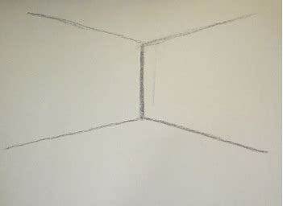

Visual Observers
Corner
Phil Whitebloom
March 16th – Robinson Nature Center
Public Outreach – Galileo Telescope Building
Orion Nebula
4” (105mm) Astro Physics Refractor
Manual Mount

Slide 14
Member Astrophotos, Sketches, and Paintings

Slide 15
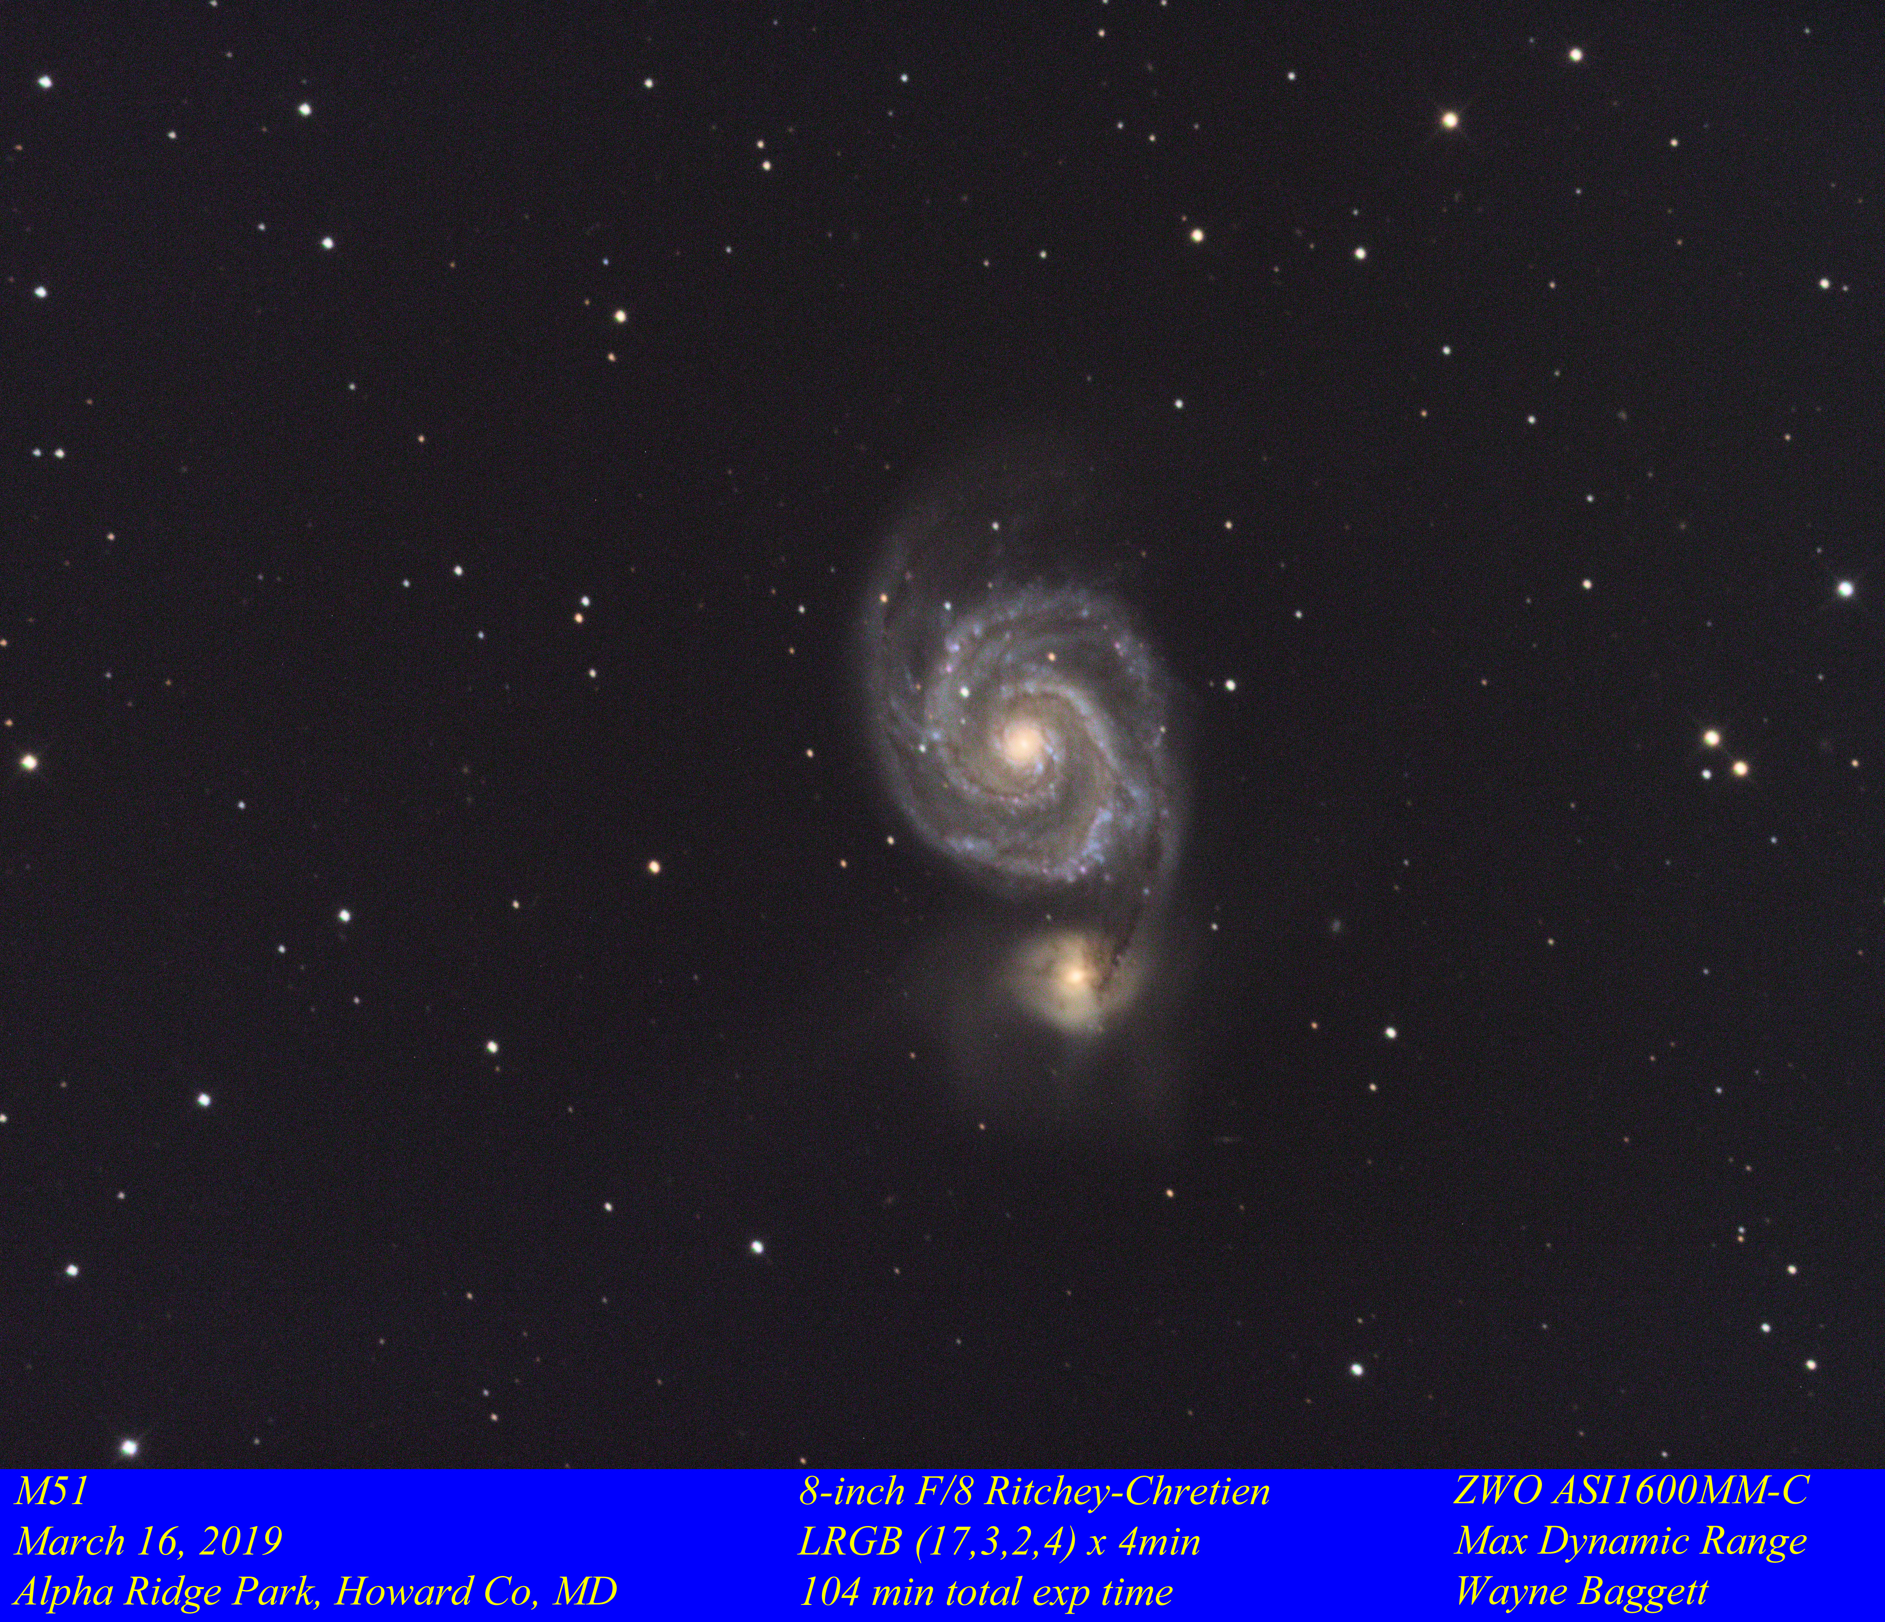

Slide 16
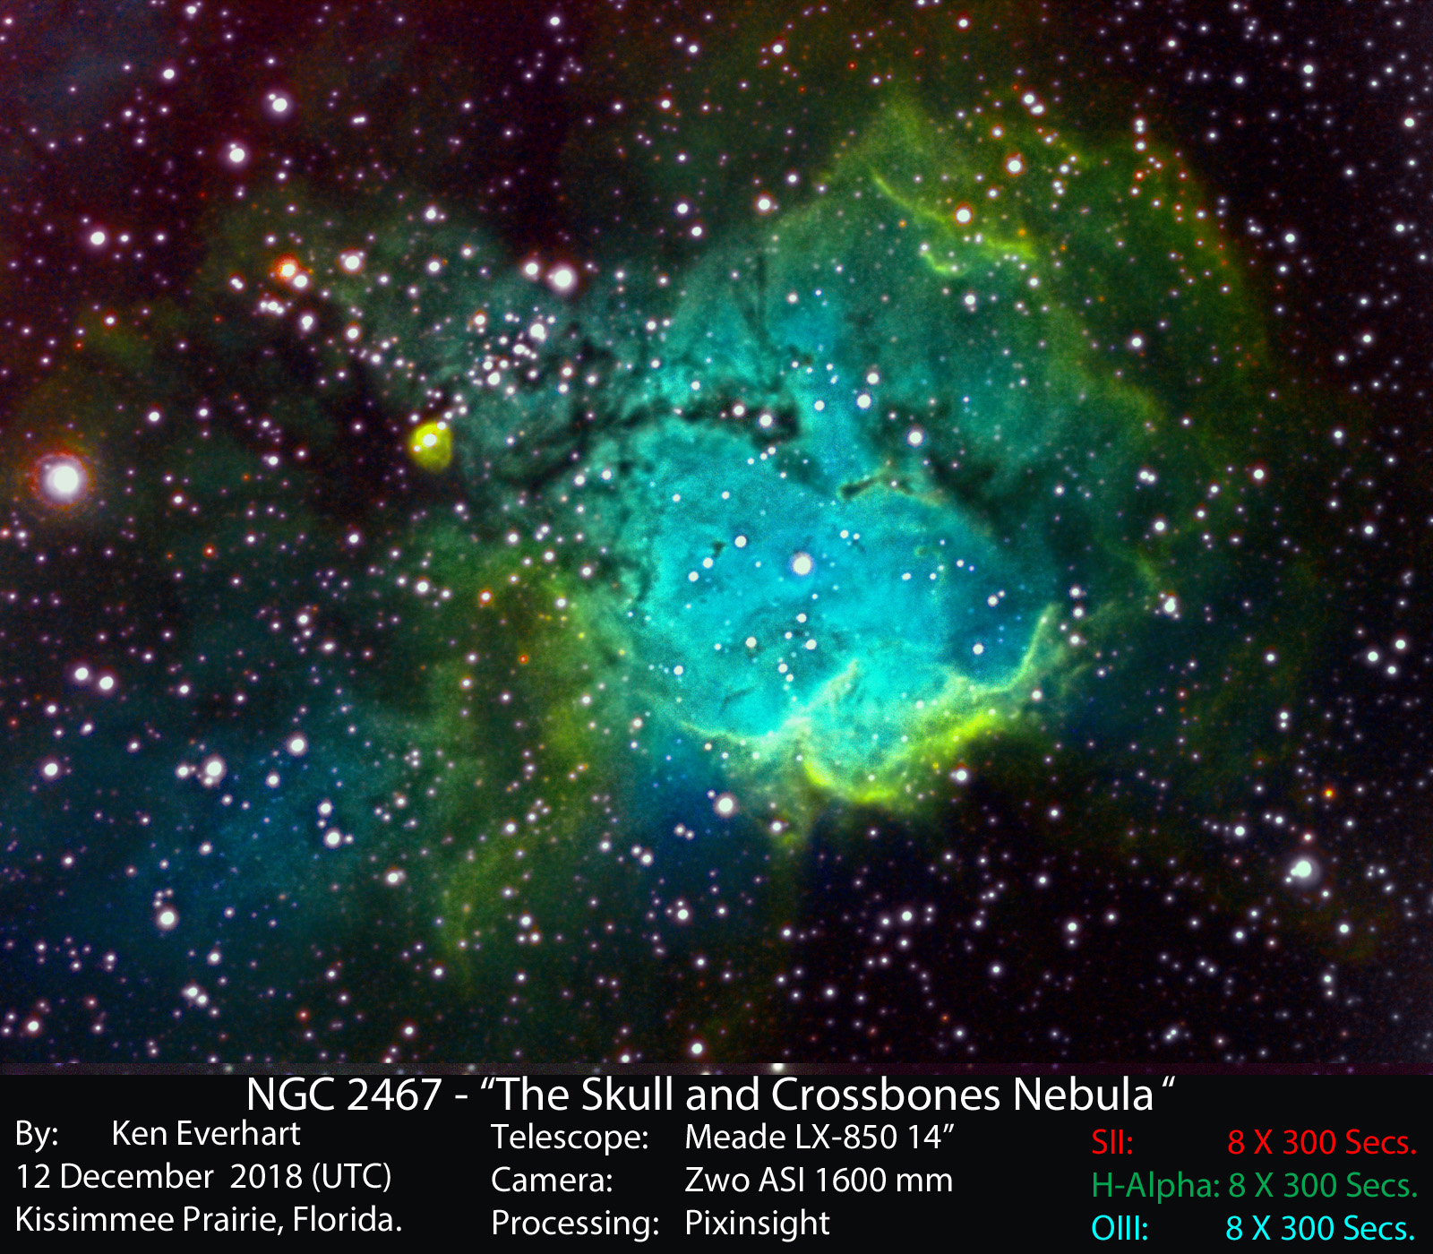

Slide 17
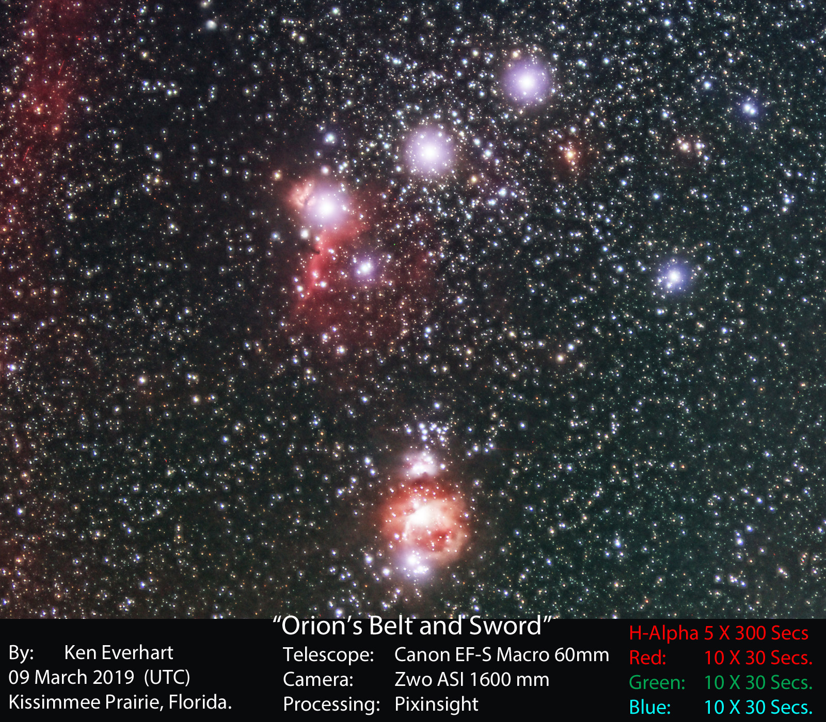

Slide 18
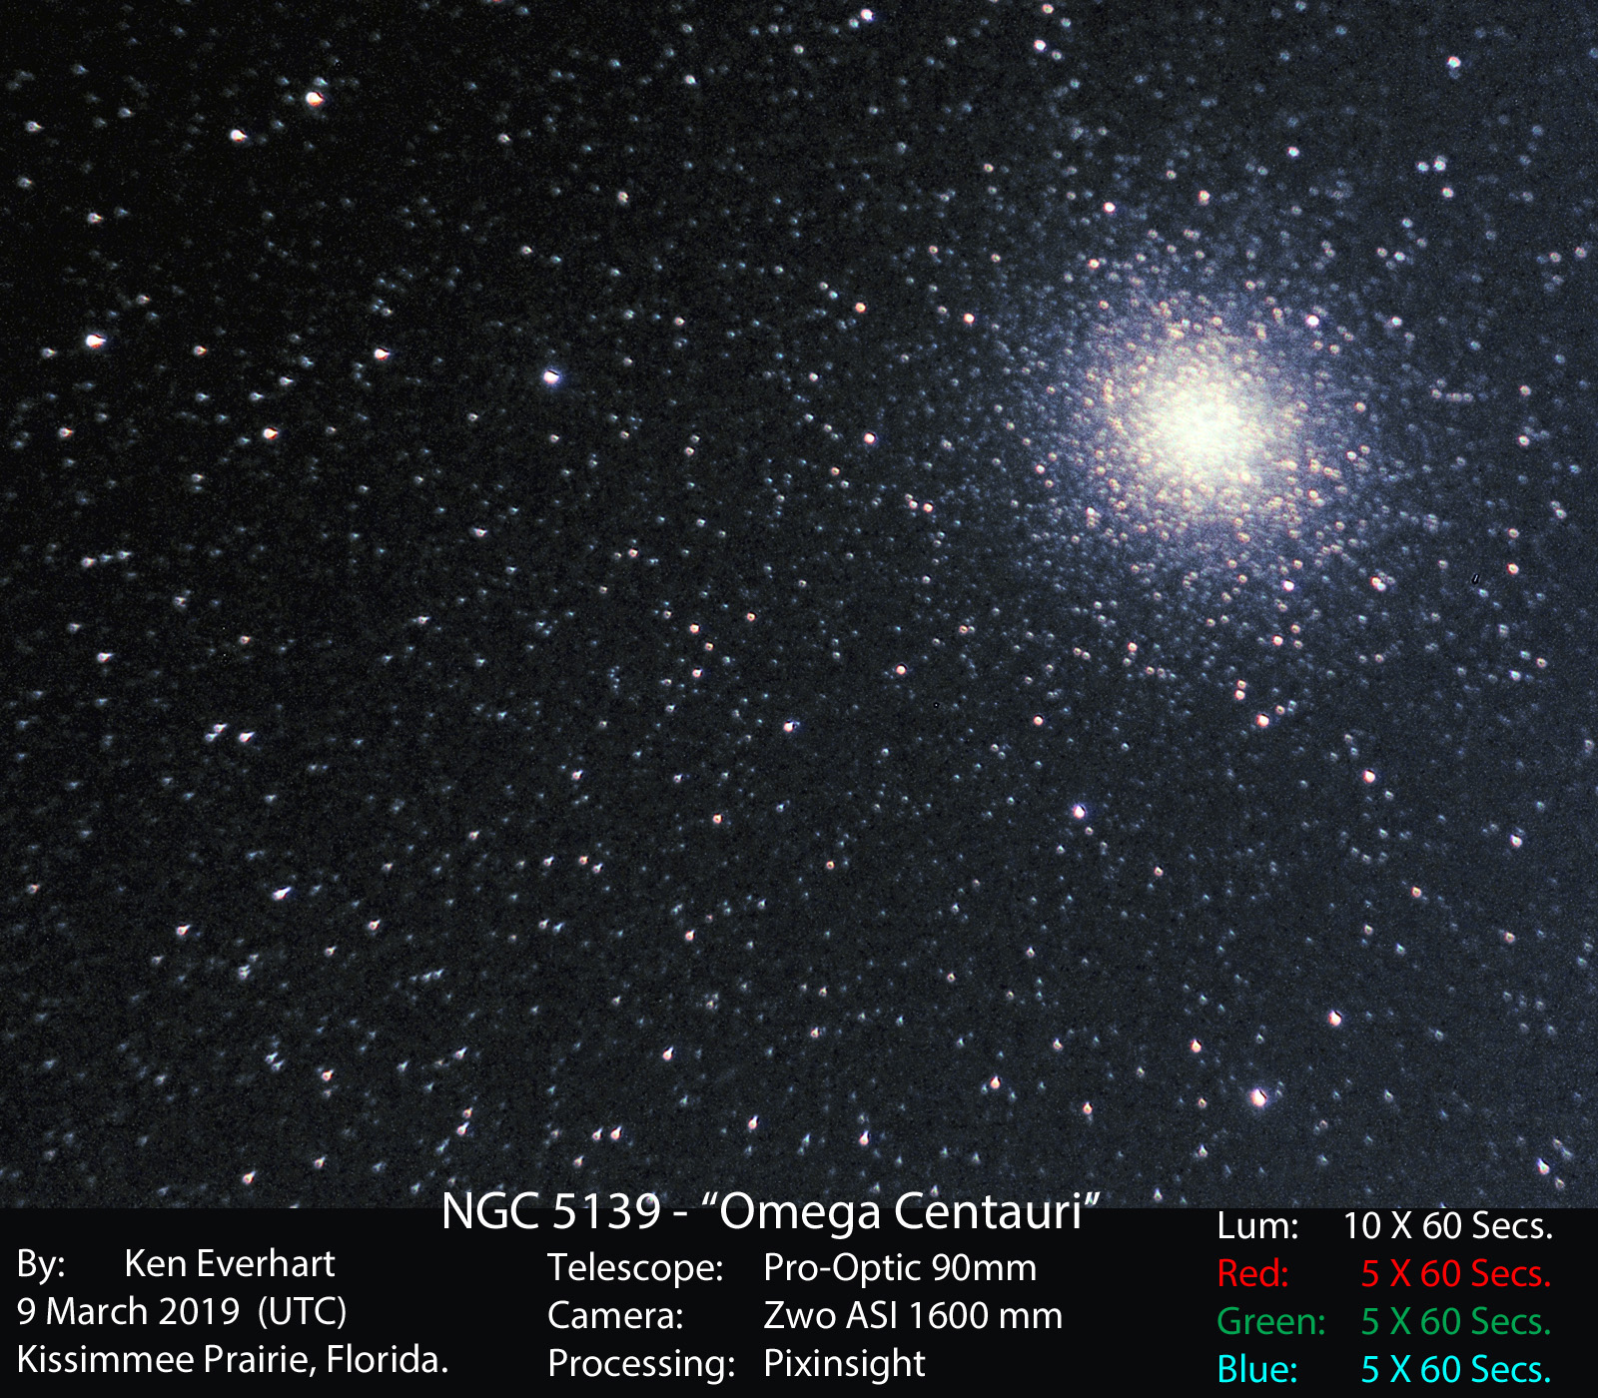

Slide 19
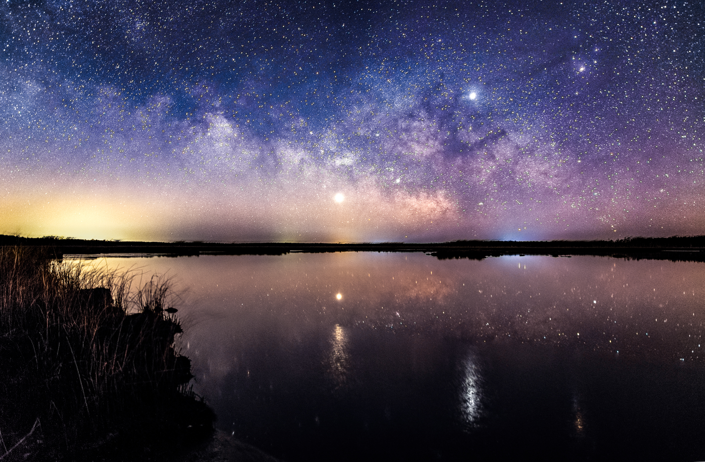
Cheryl Kerr

Slide 20
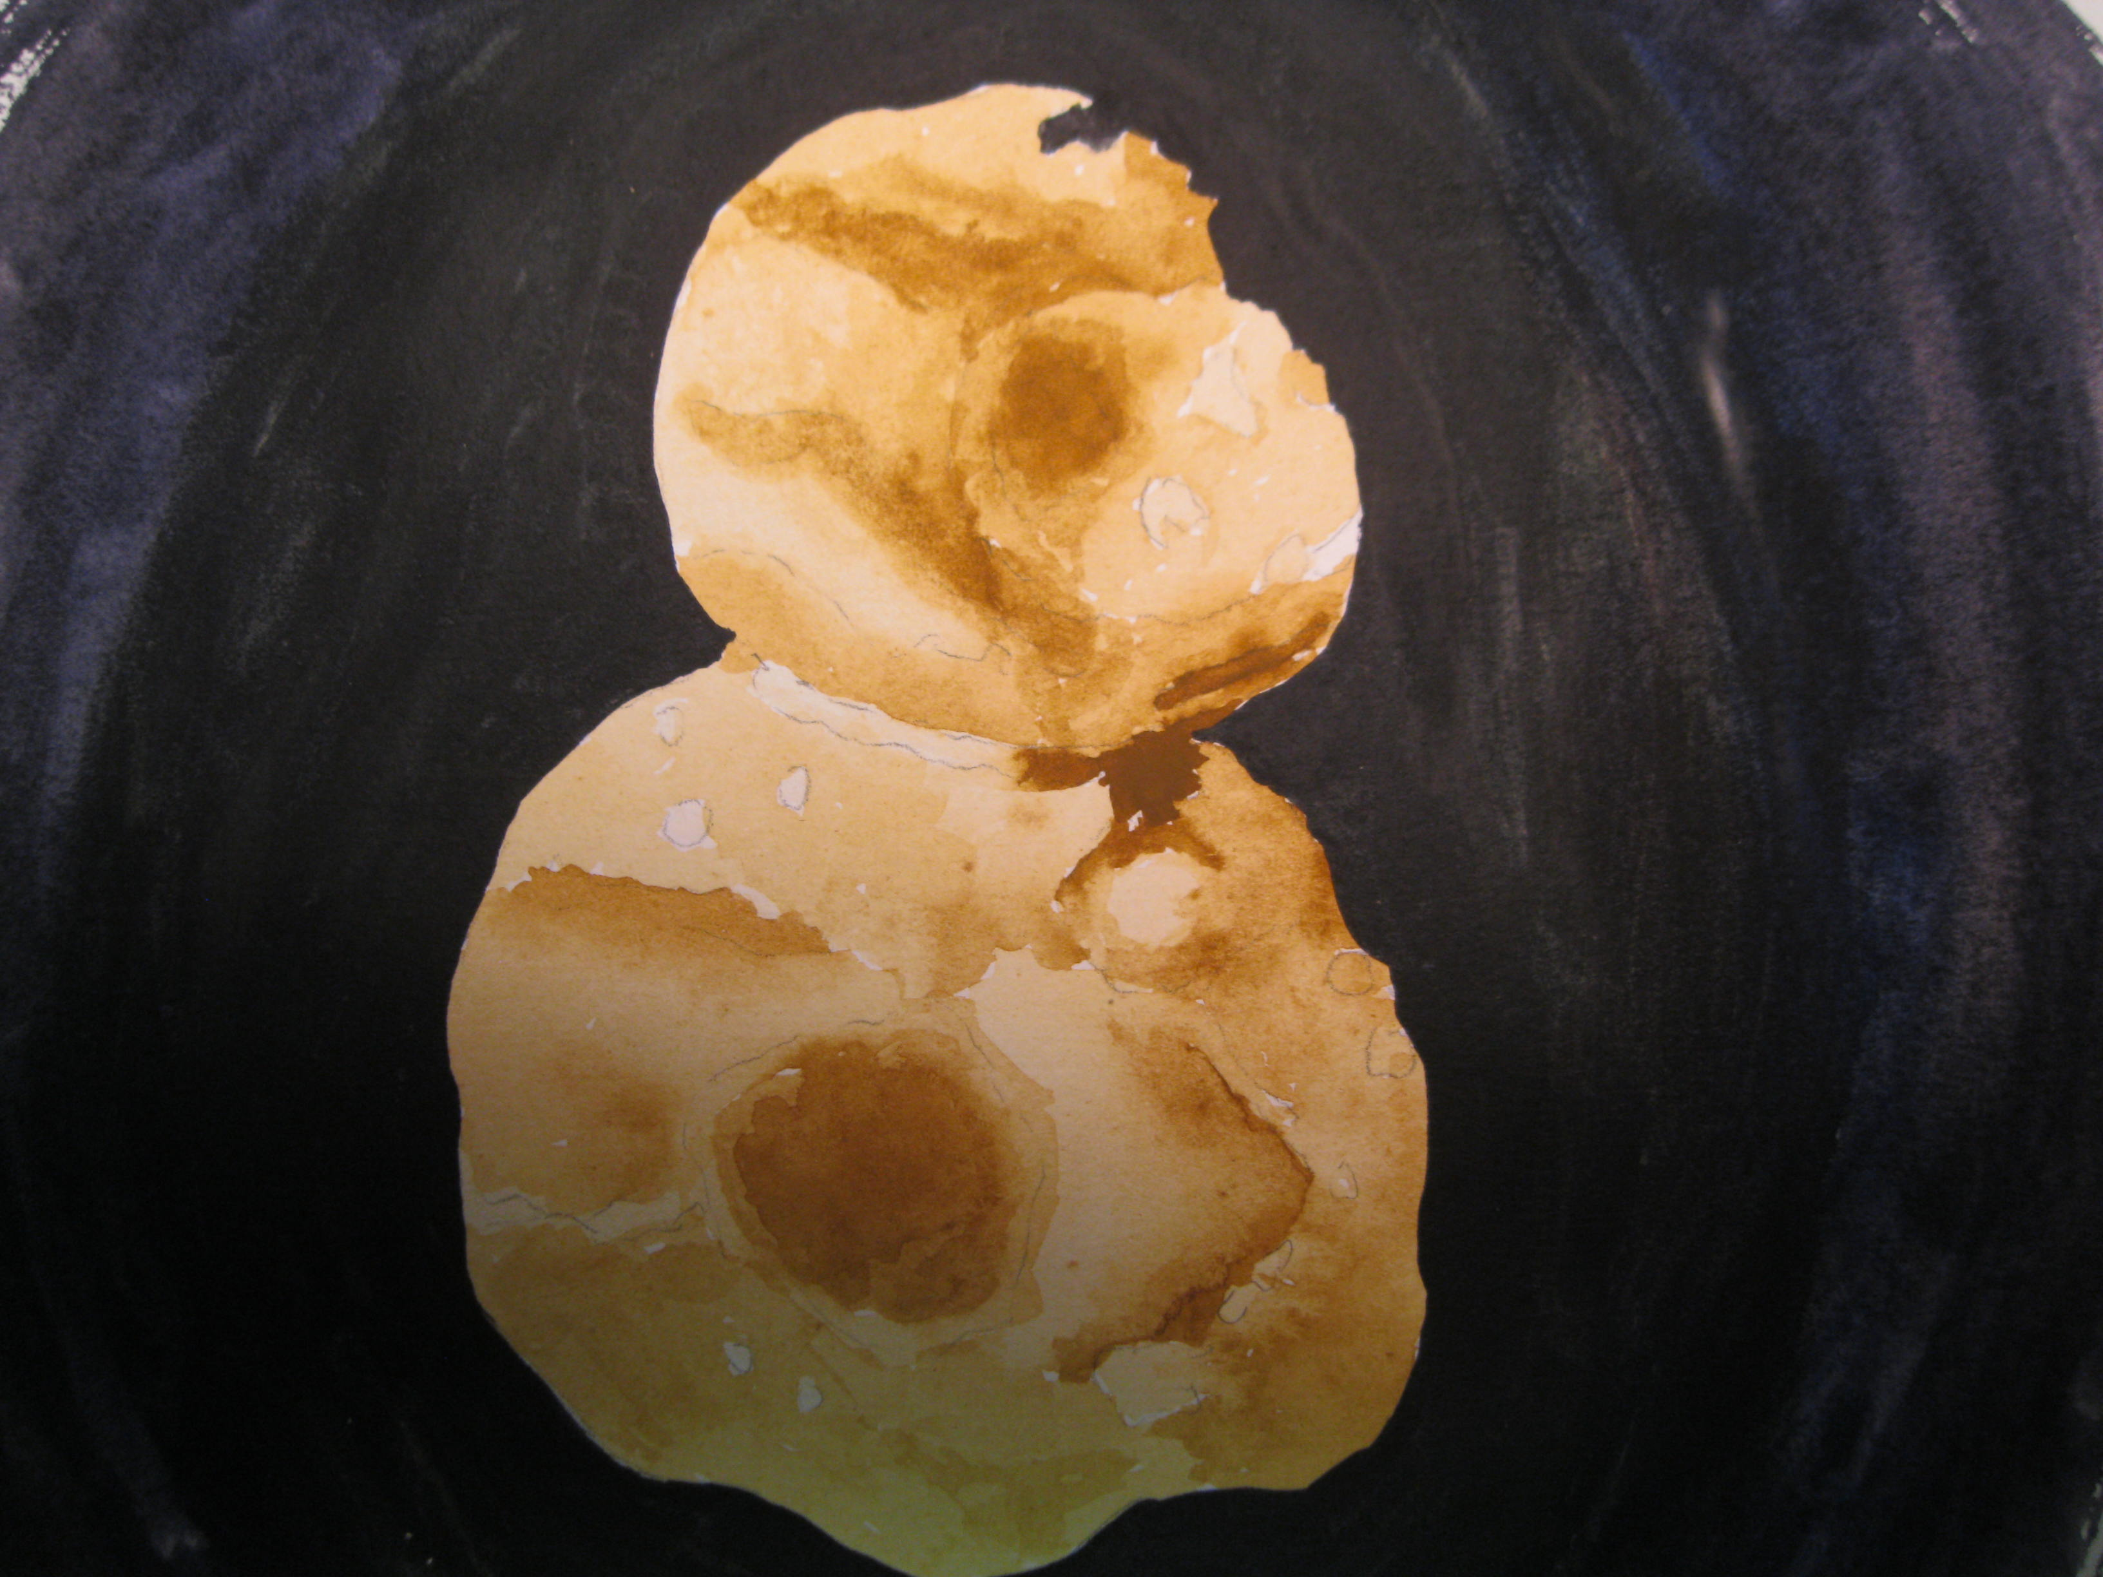
Forest Arnold
Betelgeuse
Red Super Giant
Bob Prokopf
Ultima Thule

Slide 21

Forest Arnold
Betelgeuse
Red Super Giant

Slide 22
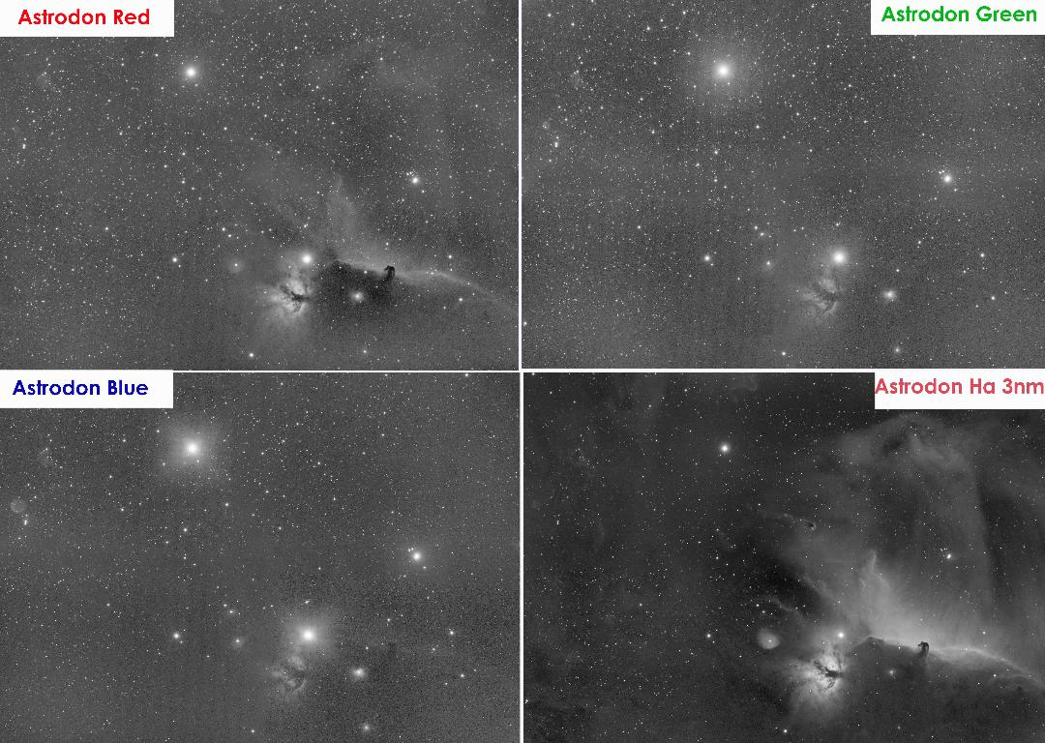
Chris Miskiewicz – His work in progress

Slide 23
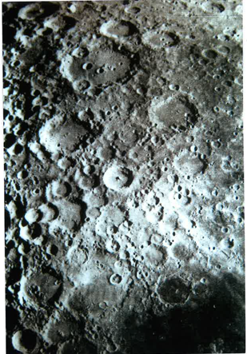
Herman Heyn
Crater Tycho.
53.4 mi. wide, 3 mi. deep.
Central peak is 1mi high.
Named for Tycho Brahe, last important
astronomer before telescopes.
Photo: Camera handheld to the eyepiece
of 8" SCT.
Forest Arnold

Slide 24
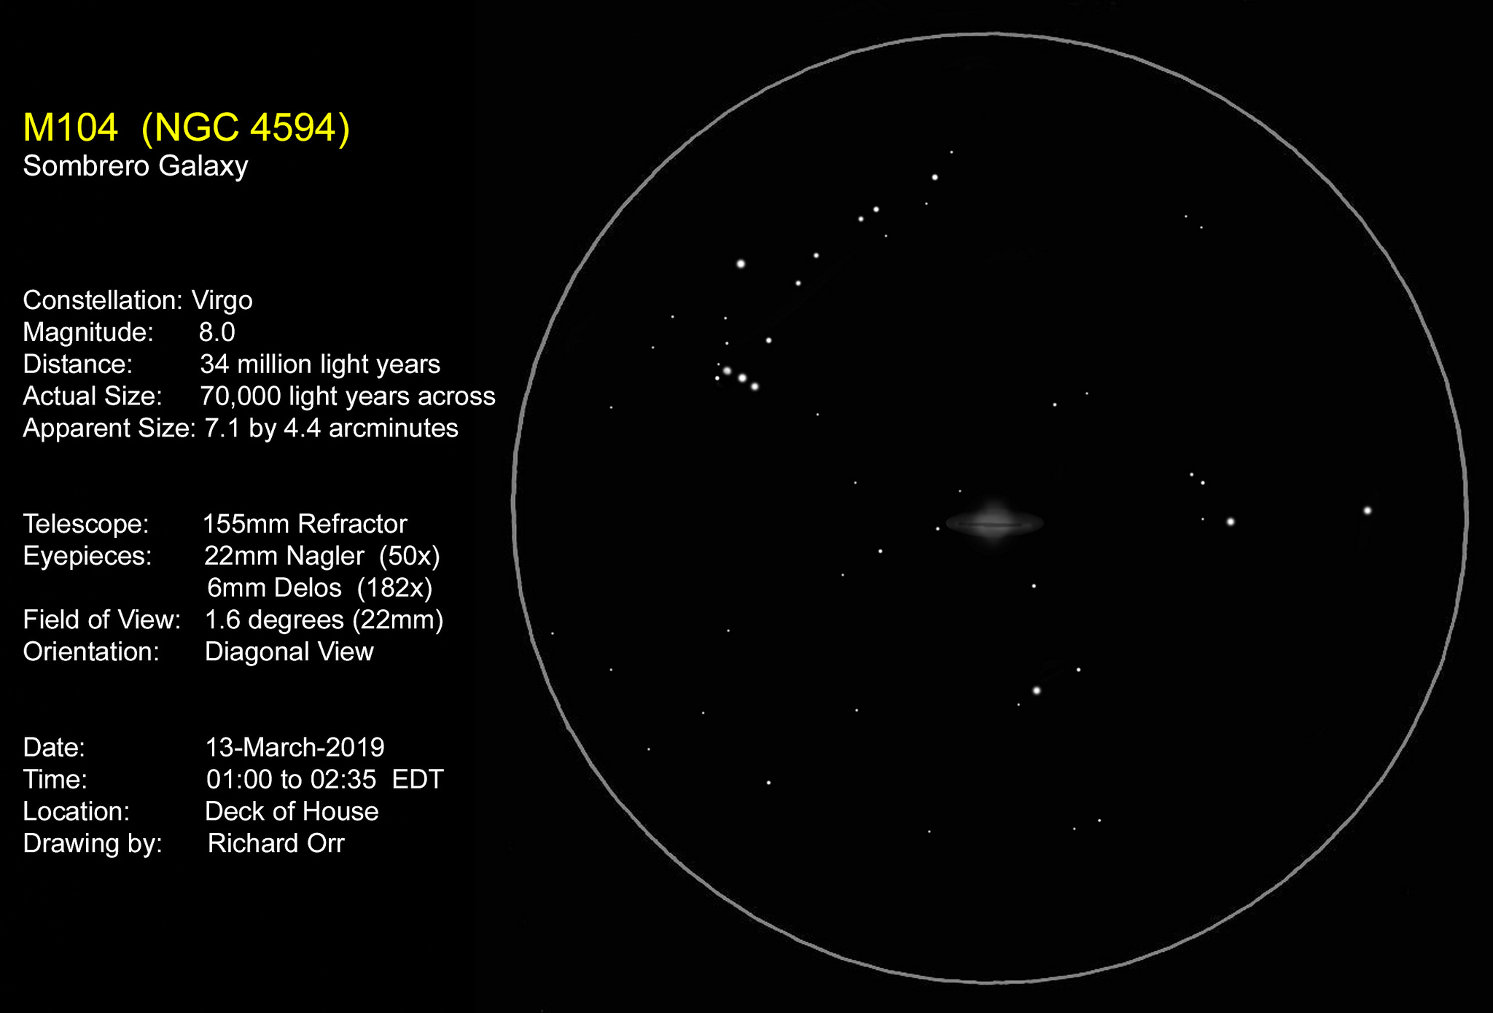

Slide 25
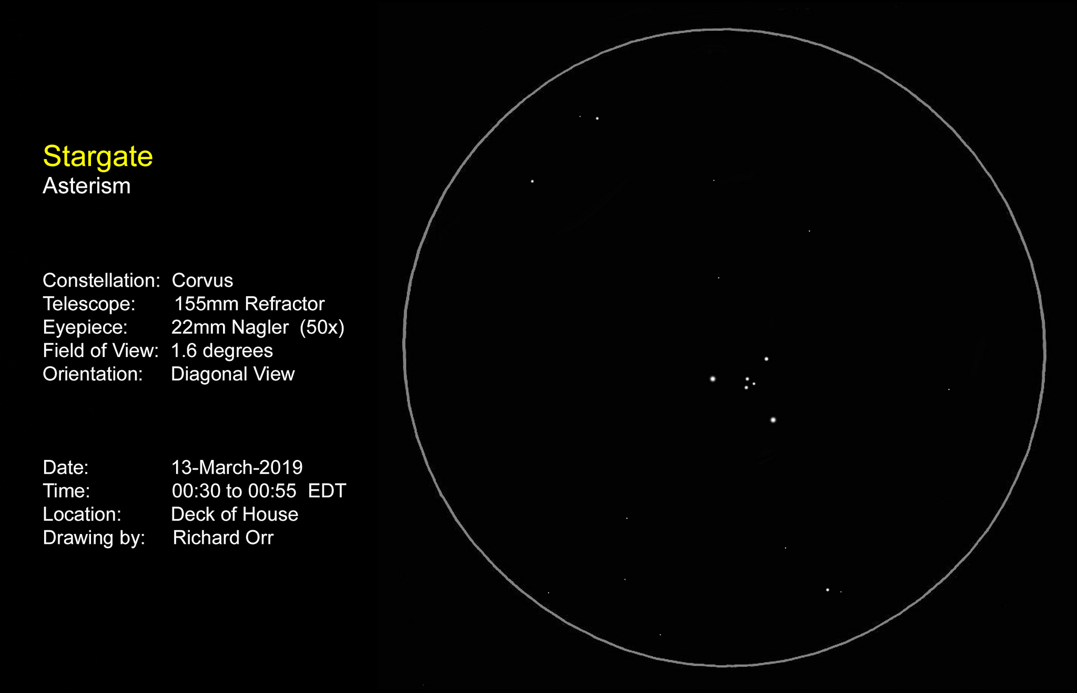
Lunar Eclipse

Slide 26
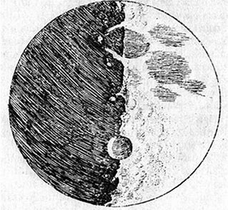
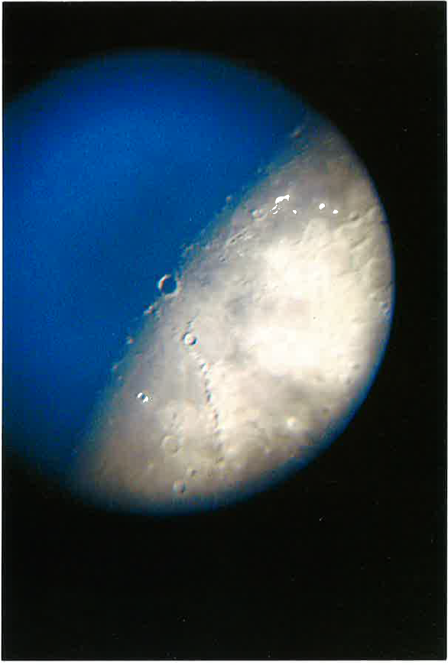
Herman Heyn
Above: Galileo’s sketch of the moon, 1610. Crater is believed to be either Albathegnius or Copernicus.
Right: 8-Day Moon with Copernicus. Photo shot during twighlight 04/26/2015 using a Canon PowerShot handheld to a 40mm Kellner (50X) thru his 8” SCT.

Slide 27
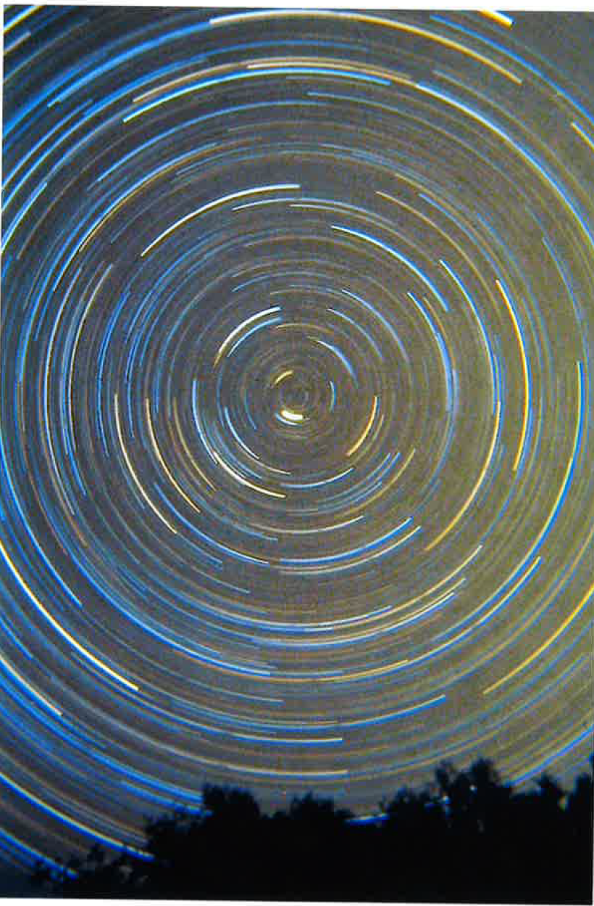
Herman Heyn
Circumpolar
1978

Slide 28

Submitted by Herman Heyn

Slide 29
Upcoming Events
April 6th-7th – NEAF – Suffern, NY
April 6th – Members Only – Alpha Ridge
April 13th – Greenfest, HCC 10:00AM-4:00PM
April 13th – Public Star Party – Alpha Ridge
April 28th-May 5th – Texas Star Party

Slide 30
Thank You!
Next month’s meeting is on Thursday, April 18th, 2019 at 7 PM
AstroSchool at 6:15
Panel Discussion
Improving your Observing Experience

